Slide 2
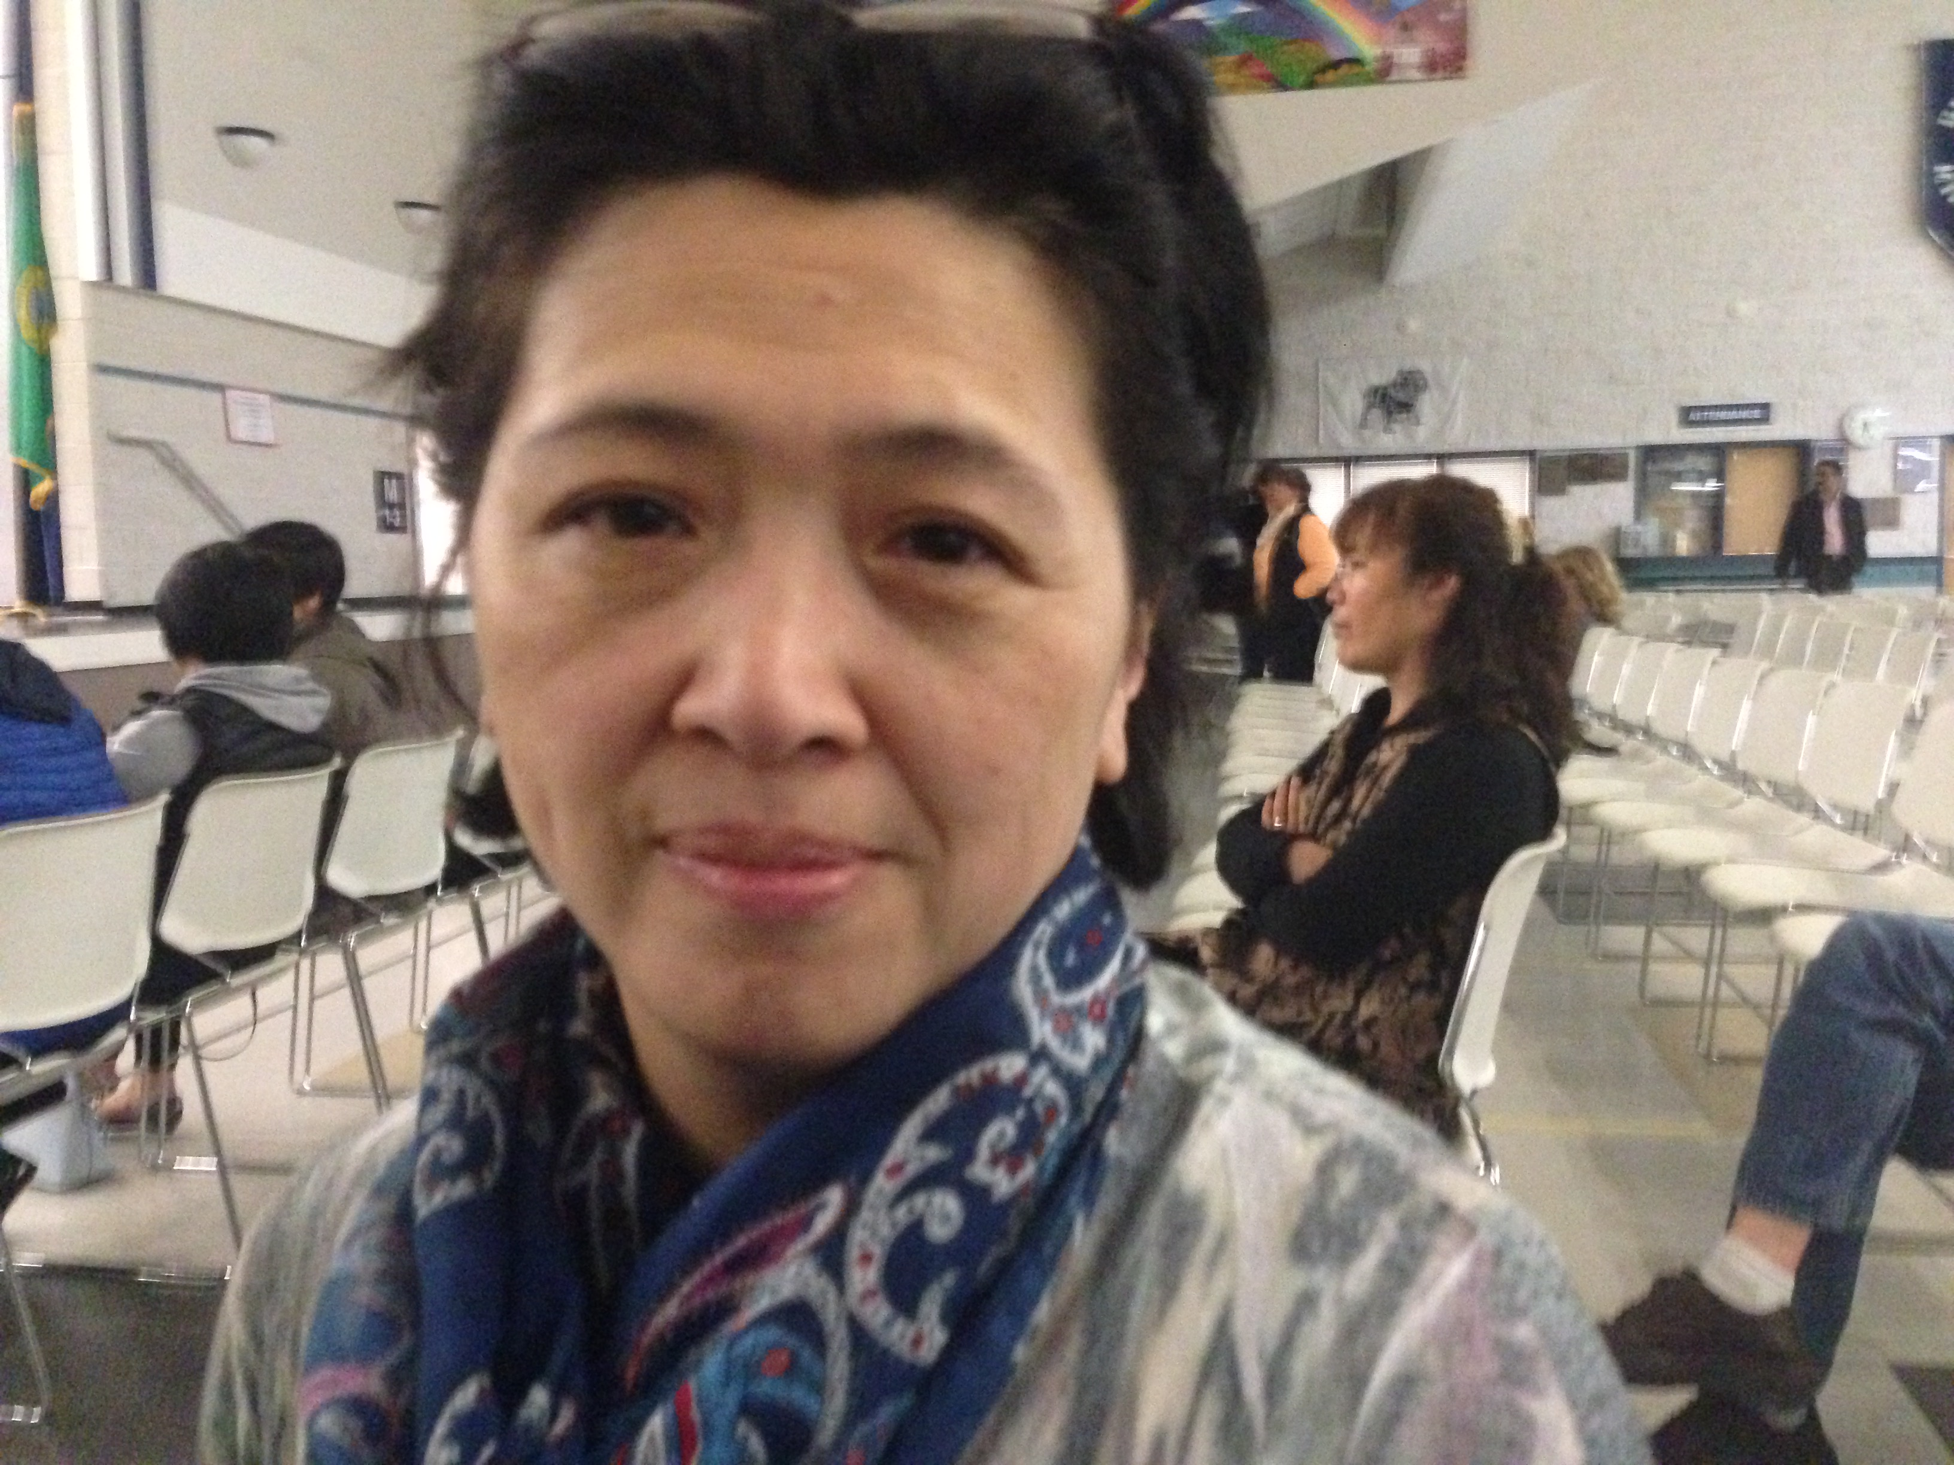
Teacher: Amanda Lin
Amanda Lin, a native Chinese speaker, grew up in Taiwan. She loves Chinese culture and folk art. She has been teaching Saturday Chinese School for 9 years. She coordinates Chinese Culture youth camp for her Chinese school and teaches Chinese folk art to local youth clubs and community.
As a Chinese teacher, Amanda Lin believes learning Chinese is not only practicing the language itself. Chinese culture and folk art should be also introduced to students. Culture and folk art bring the spirit to the language. They will make the language learning process become more interactive, vivid and fun.

Slide 3
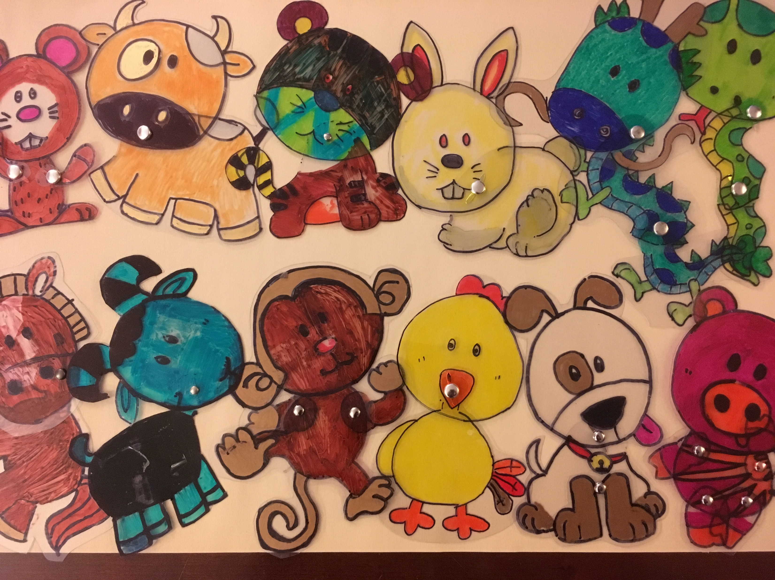
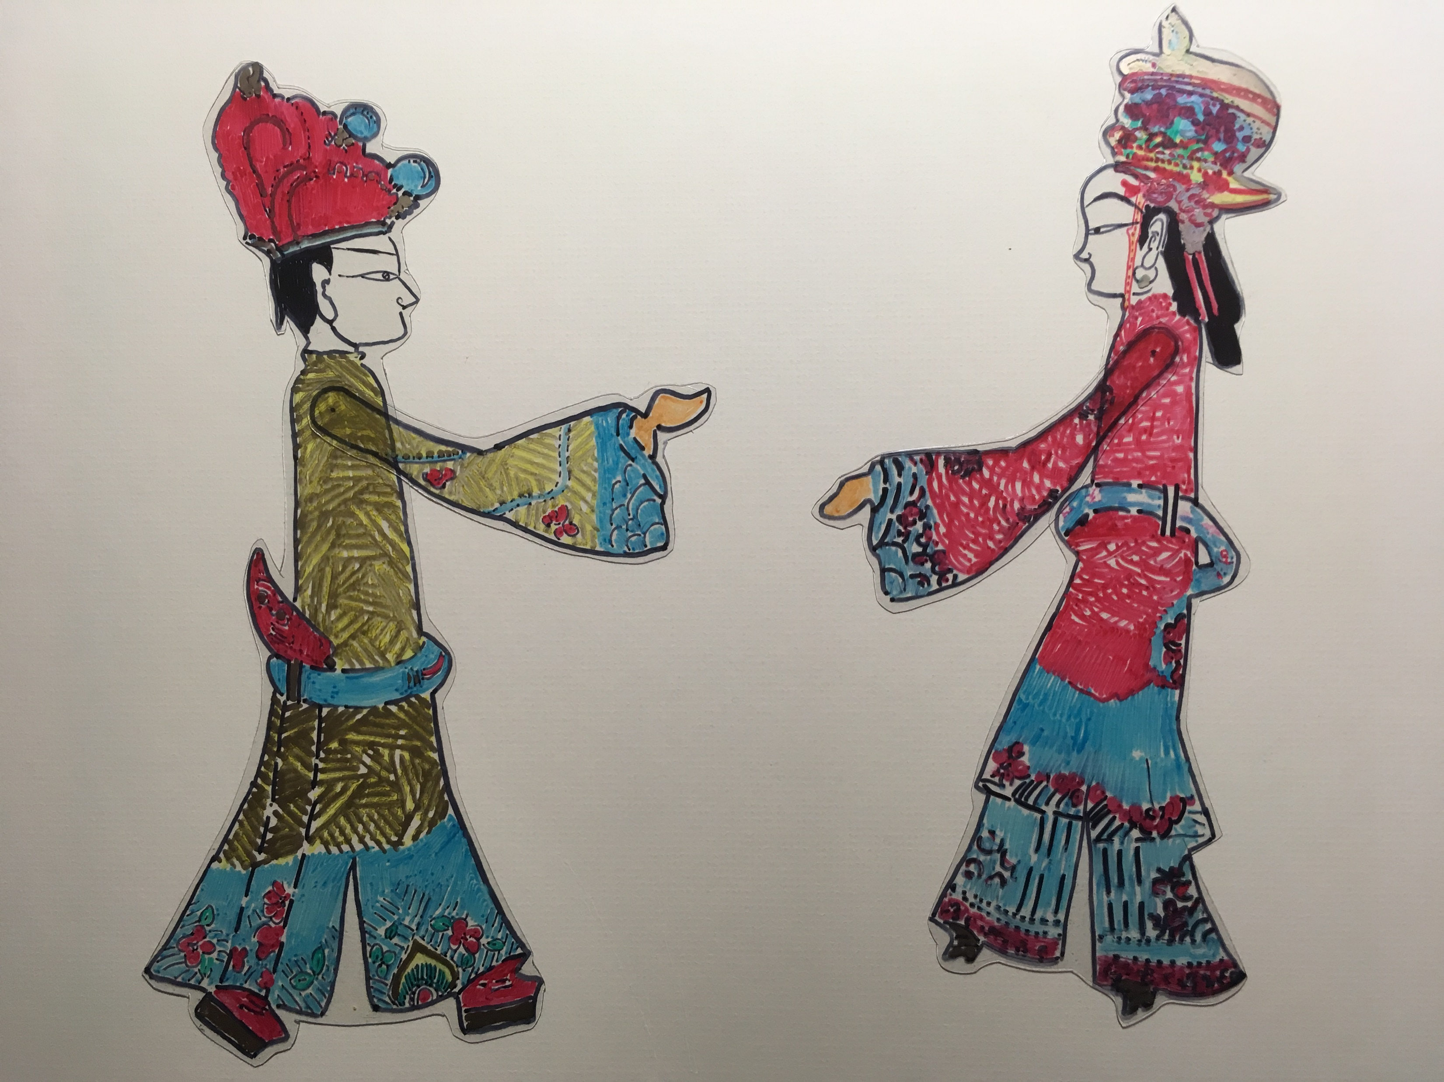
Class: Shadow Puppetry
Shadow puppetry is an ancient form of storytelling. The shadow puppets are held onto a translucent screen. The source of light makes puppets' shadows shown on the screen. puppeteers can make the figures appear to walk , dance and fight.

Slide 4

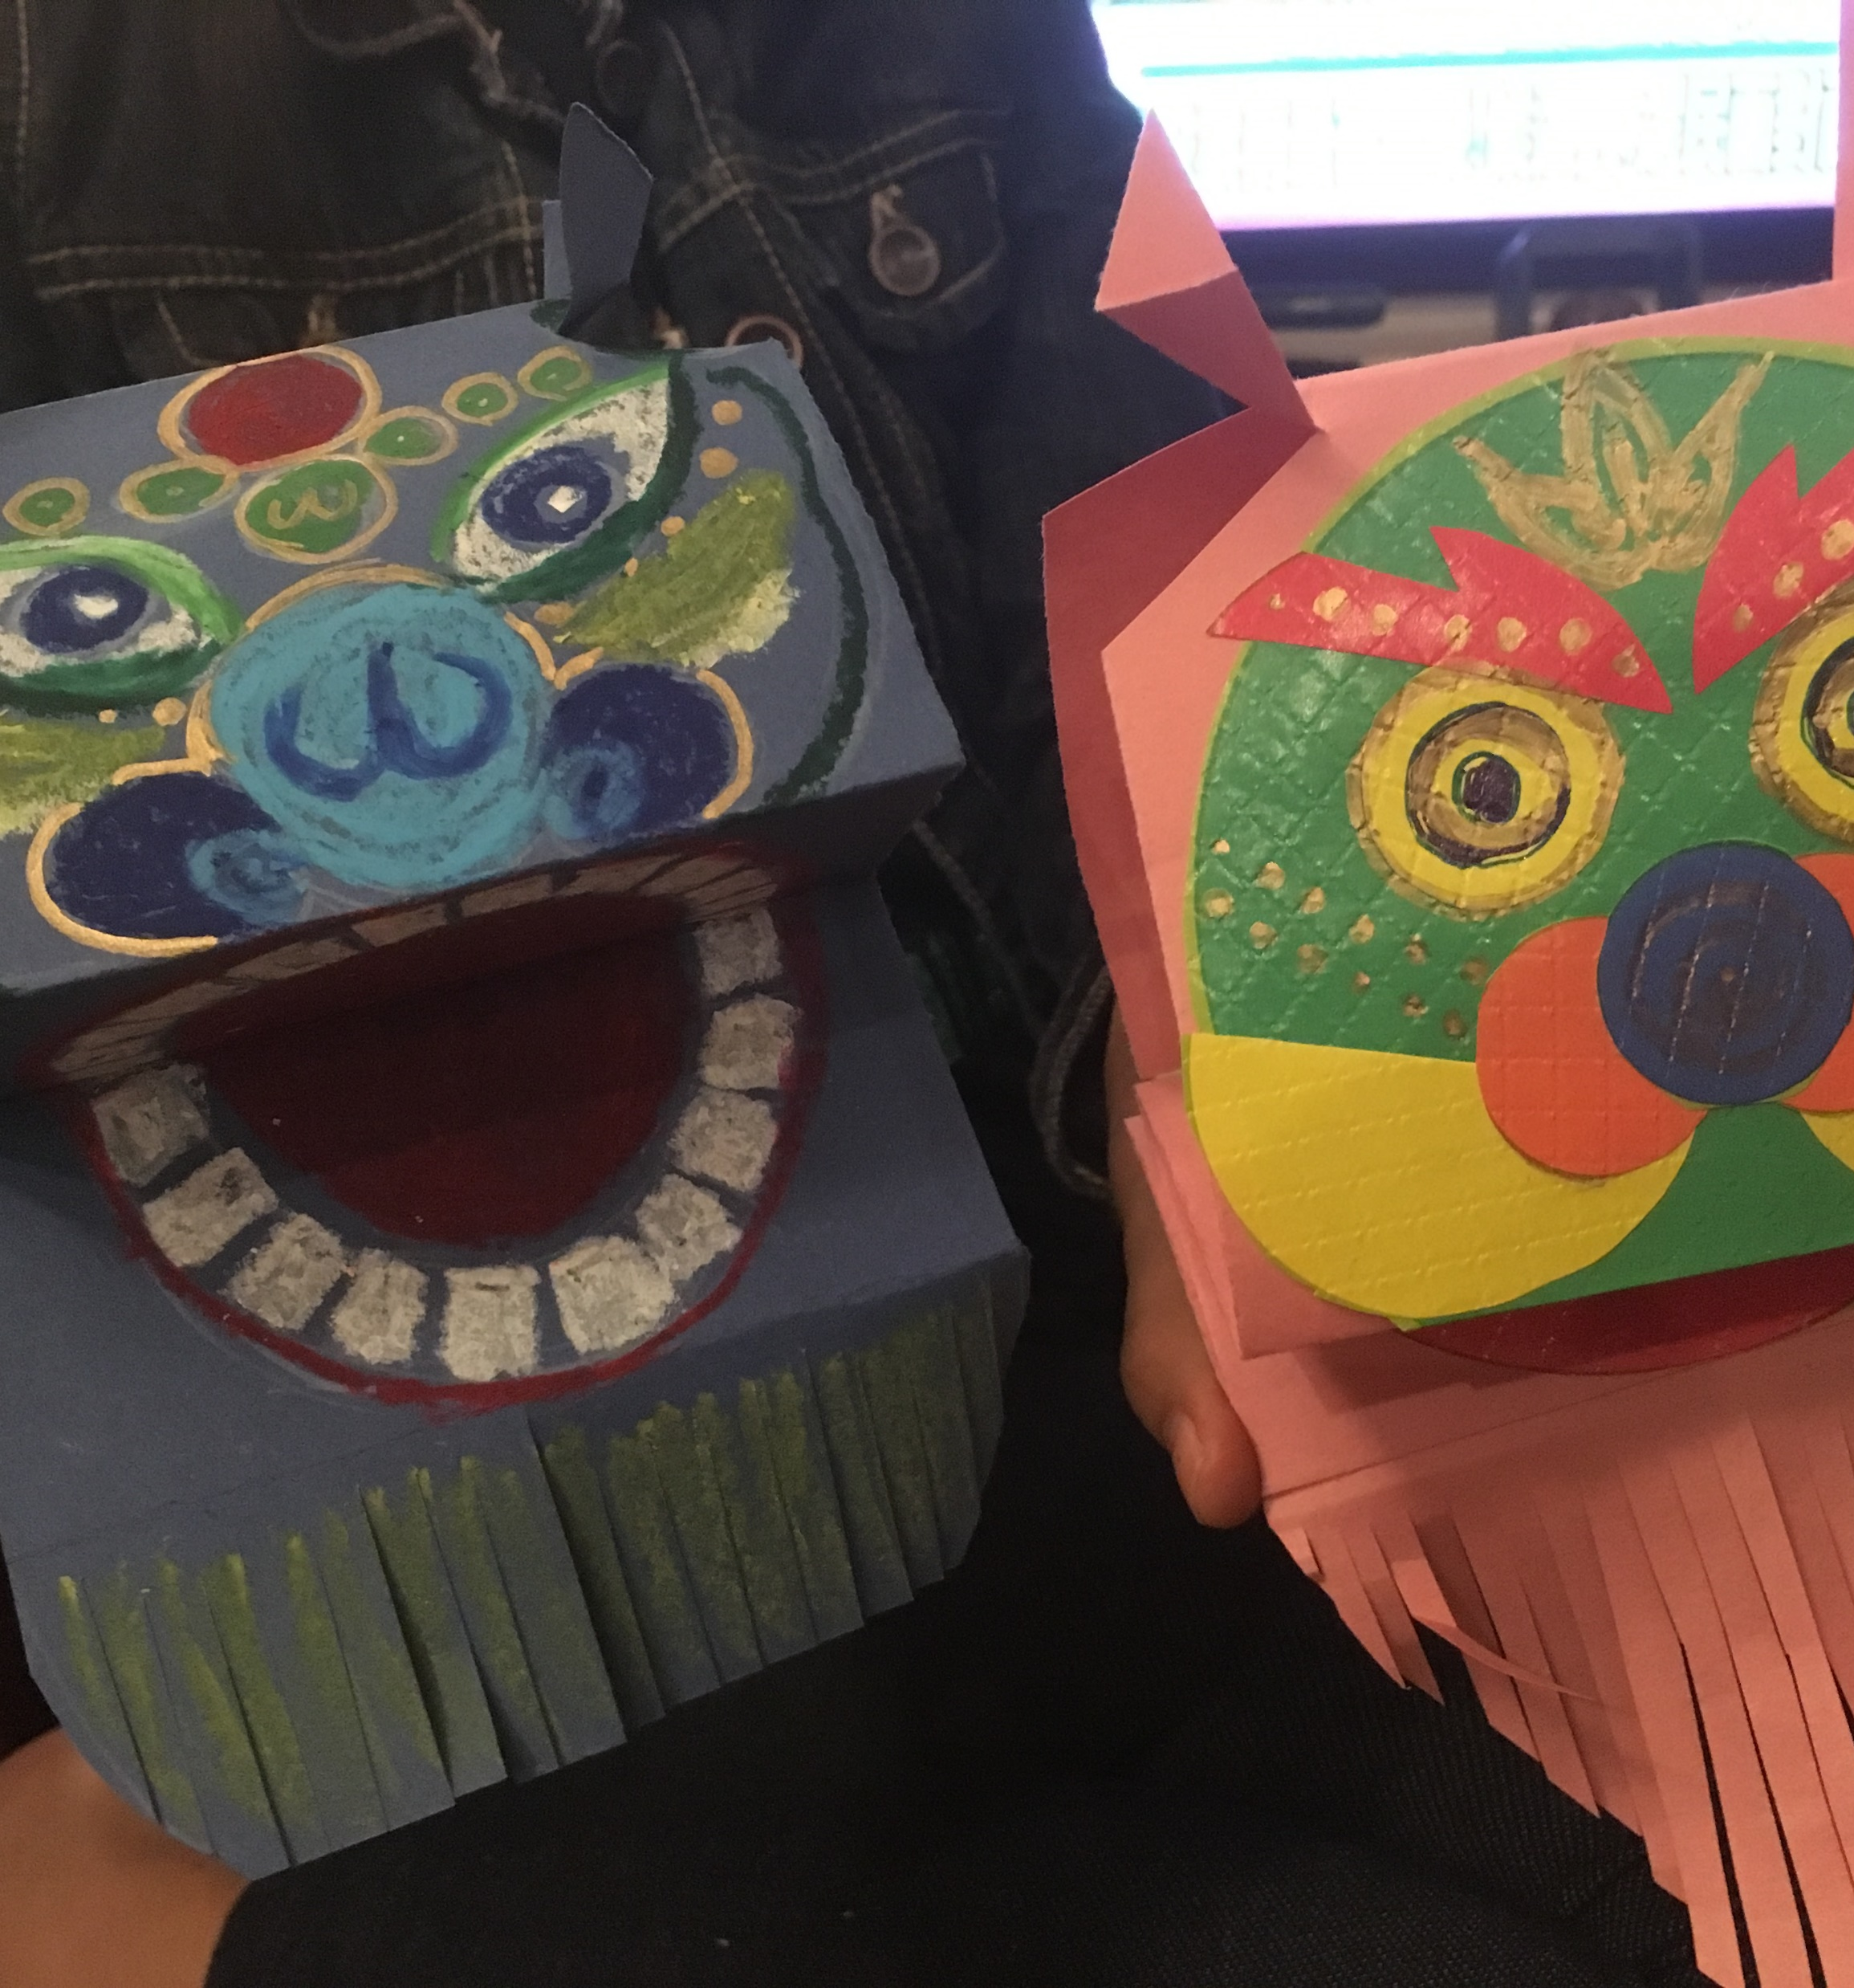
Class: Lion Dance
The Chinese lion dance is usually performed during Chinese New Year and religious festivals. People believe a dancing lion scared away the bad spirits and bring a good luck to everyone.

Slide 5
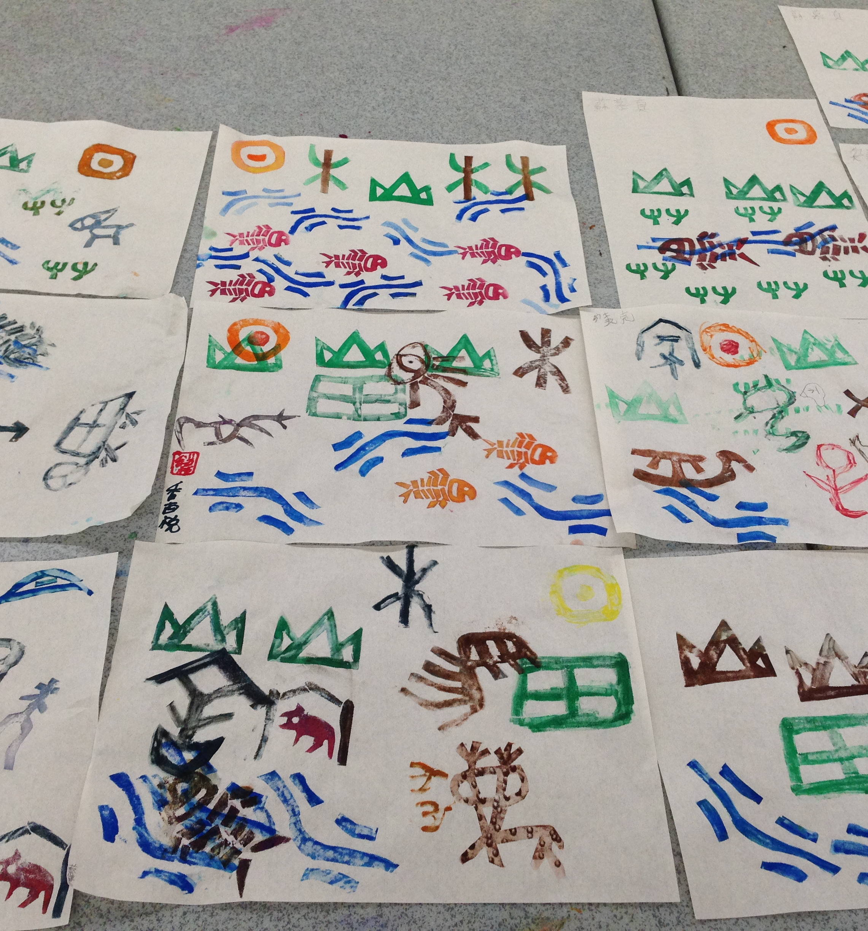
Class: Ancient Chinese Characters
One of Ancient Chinese Characters is known as the oracle bone script(jia gu wen). They looks like images of the objects such as the sun, the moon, mountains and water. We will create pictures by ancient Chinese Characters. Can you tell a story from the picture?

Slide 6
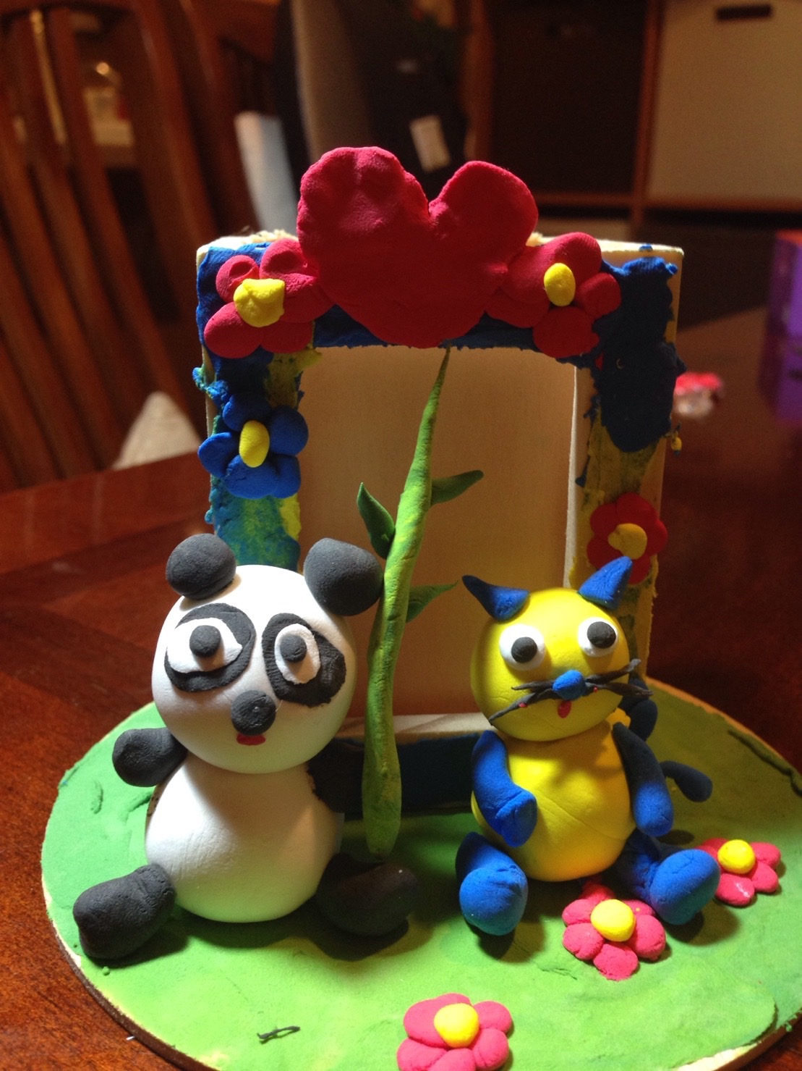
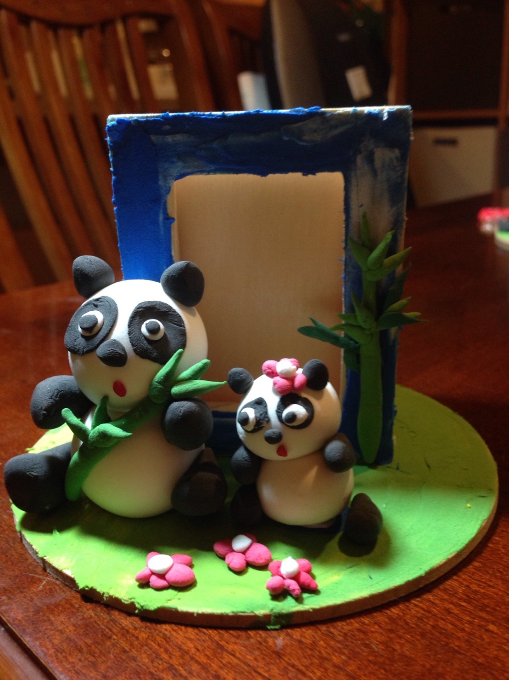
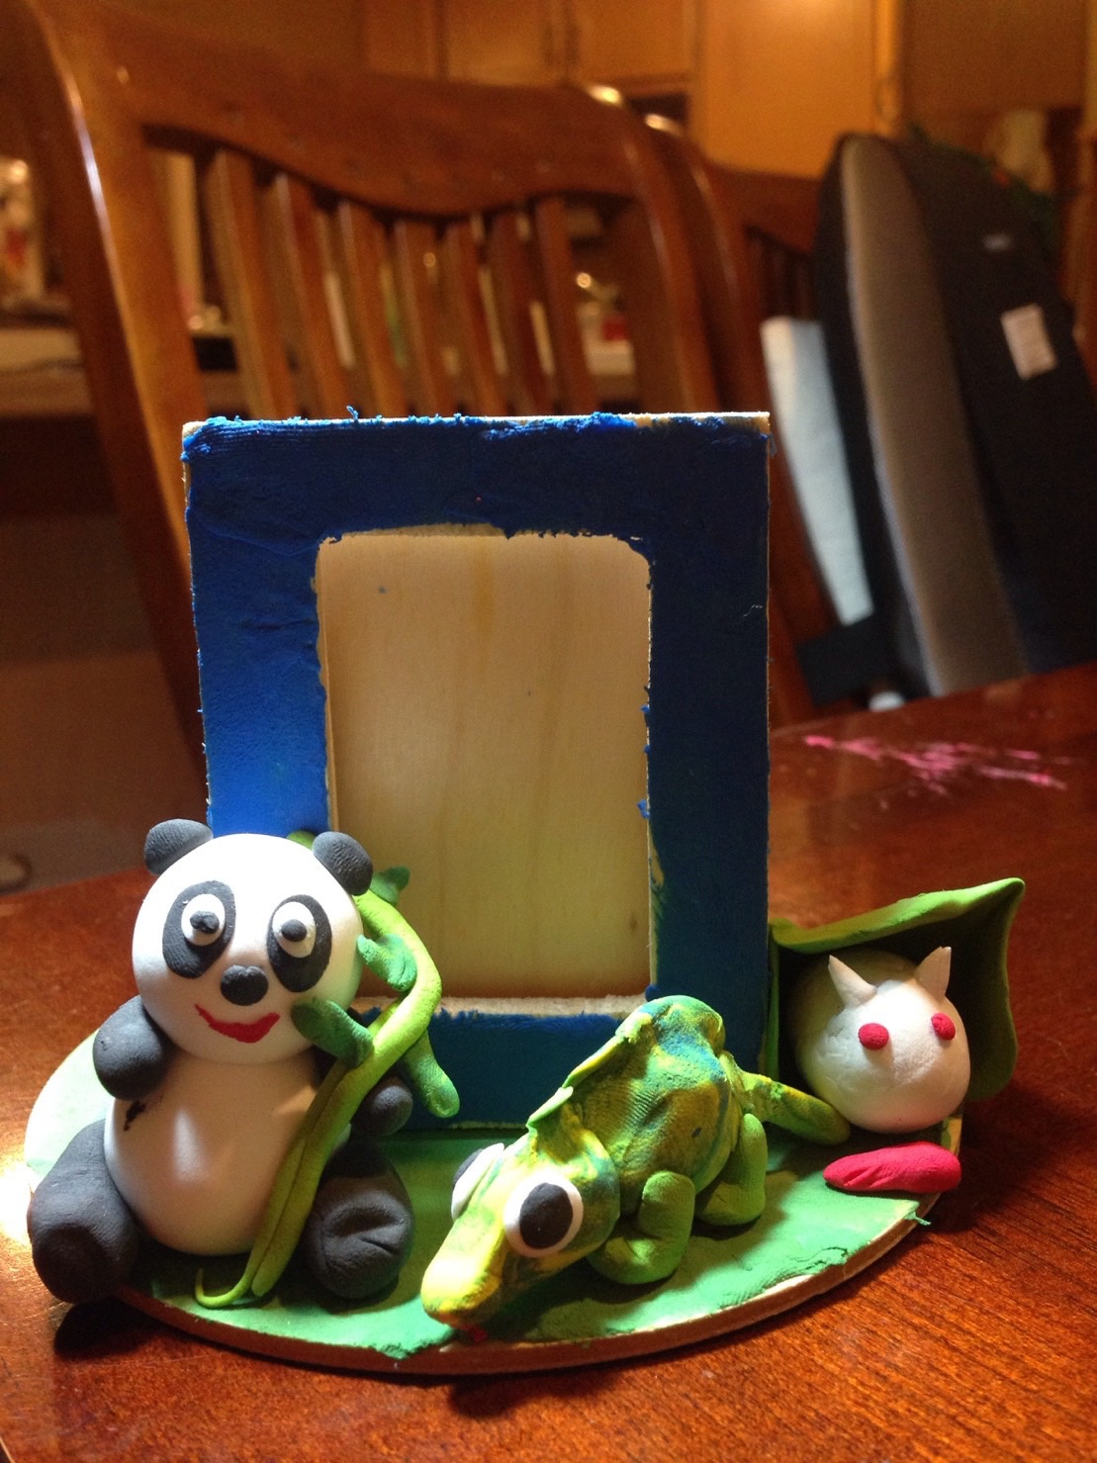
Class: Dough Figures
Dough Figure making began in the Tang Dynasty and has been around 1000 years. Originally, these edible dough figures were made for temples. Currently, dough figures are sold at the night markets or temple fairs in China or Taiwan. People collect dough figures in stead of eating them.

Slide 7
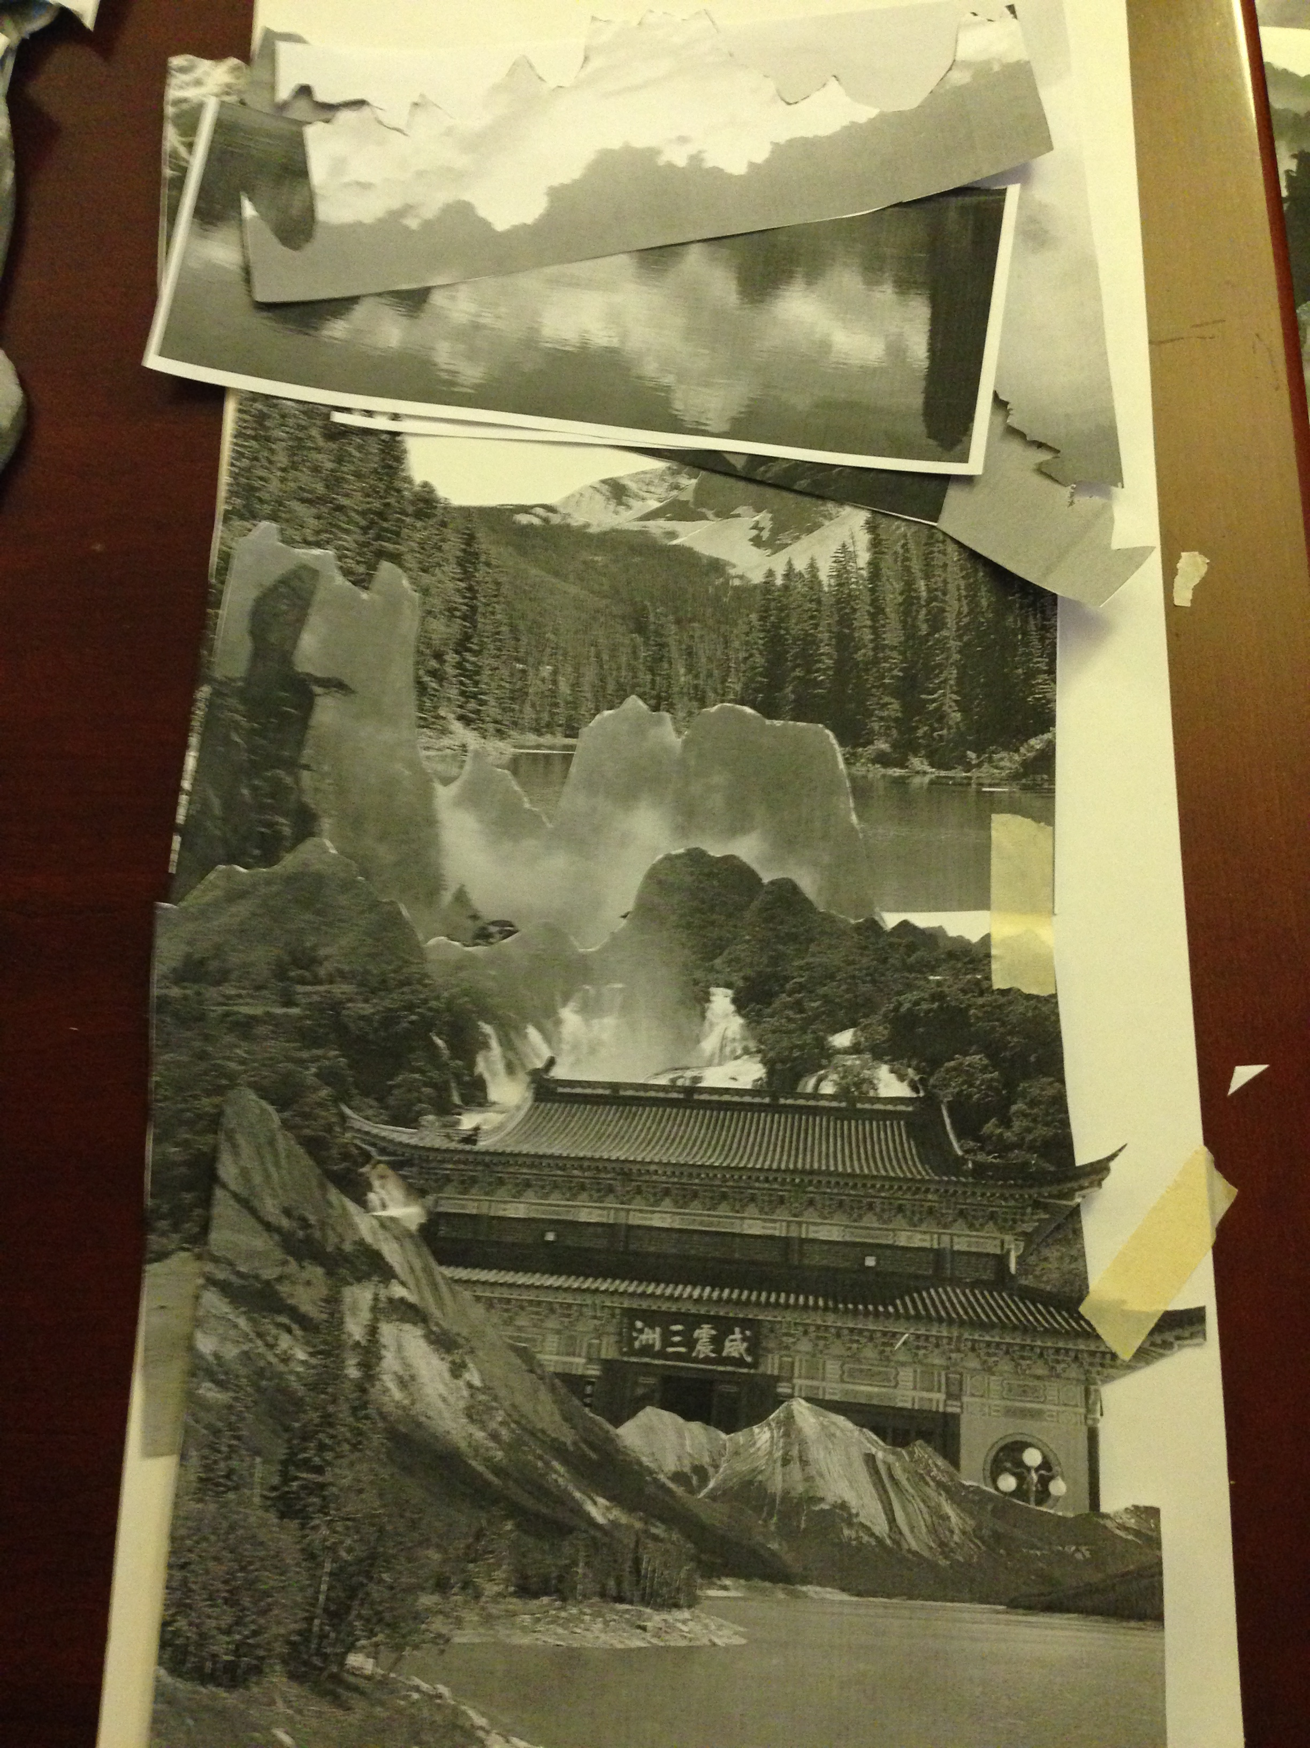
Class: ShanShui Hua
Landscape painting, Shan Shui Hua, is regarded as the highest form of Chinese painting. The mountains can be towering mountains or rolling hills. The classical styles of Chinese landscape painting are used the black ink and applied brush techniques to create different scales of black/ gray colors and textures.
We apply the collage technique to create a “ShanShui Hua” style art project.

Slide 8

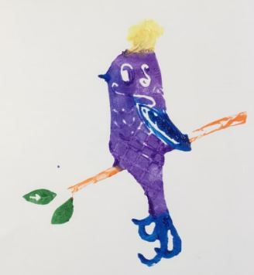
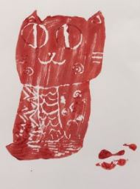
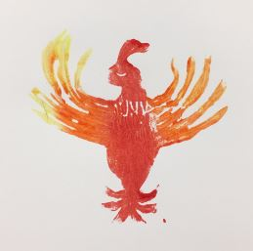
Class: Nian Hua
Woodblock printing was invented in ancient China around 1000 years ago (in Tan Dynasty). Woodblock printing was mainly used for printing books as well as images. The woodblock-printed images are still produced nowadays such as Nian Hau – auspicious images for Chinese New Year.

